Slide 1














CHAPTER #5
The 22 Immutable Laws of Branding

Slide 2
THE LAW OF WORD

Slide 3

STATEMENT
"A brand should strive to own a word in the mind of the consumer."

Slide 4
IMPORTANCE:
In the competitive landscape of branding, mastering the principles of brand ownership is crucial for establishing a strong and lasting presence in consumers' minds. These principles align with the Law of the Word, emphasizing the importance of owning a singular idea or concept to resonate effectively with audiences..

Slide 5
INTRODUCTION TO BRAND OWNERSHIP
Brand Ownership is owning a word that signifies a brand' association with a specific trait or attribute that distinguishes it in the market.
Objective:
Understanding the impact of this association on
consumer behaviour and market positioning.

Slide 6
MERCEDES BENZ- PRESTIGE IN BRANDING:
Brand Focus: Mercedes-Benz's core differentiation based on the word "prestige" in consumers' minds.
Attributes: Expensive, German engineering, and reliability contribute, but prestige remains the defining factor.

Slide 7
VOLVO - DOMINANCE IN SAFETY
Brand Association: Volvo's strategic ownership of the word "safety" in the automobile industry.
Success Story: Volvo's rise as the largest-selling European luxury car in America due to its relentless focus on safety.
Consumer Perception:Volvo's safety-centric branding has shaped consumer trust and preference.

Slide 8
BMW–FOCUS ON DRIVING EXPERIENCE
Brand Positioning: BMW's brand is synonymous with "driving" and the ultimate driving experience.
Strategy Impact: BMW's focus on driving pleasure has contributed to its position as the second-largest-selling European luxury car in America.
Consumer Engagement: Brand association influences consumer loyalty and emotional attachment.

Slide 9
THE CHALLENGE OF BRAND DIVERSIFICATION
Common Mistake:The pitfalls of brands broadening their focus, using examples from Mercedes, Volvo, and BMW.
Consequences: Potential risks and consequences of diluting a brand's core identity by venturing into unrelated markets or attributes.

Slide 10
KLEENEX: DOMINANCE IN TISSUE CATEGORY
Case Study: Kleenex's establishment as the leading brand synonymous with "tissue" due to focused marketing efforts.
Market Impact: Kleenex's relentless focus on the tissue category led to its dominance despite variations in product types.

Slide 11
CATEGORY OWNERSHIP STRATEGIES
First-Mover Advantage: The significance of being the first in a category to attain generic brand status.
Examples:Jell-O, Coca-Cola, Band-Aid, Saran Wrap, and Rollerblade to emphasize the impact of pioneering a category.

Slide 12
CREATING NEW CATEGORIES THROUGH FOCUS
Strategy: The strategy of creating a new category by narrowing focus, citing the example of Emery Air Freight and Federal Express (FedEx).
Success Story: Federal Express's transition to a global powerhouse by focusing on "overnight delivery" and becoming a generic term for it.

Slide 13
STRATEGIES FOR BRAND BUILDING:
Narrowing the brand focus
Creating a new category
Being the first in a category

Slide 14


KEY IDEAS
CATEGORY OWNERSHIP
BRAND DILUTION
Brands that dominate a specific category are seen as leaders, making it challenging for competitors to displace them.
Diversifying into multiple areas can dilute a brand's core identity, potentially weakening its position in consumers' minds.
Example -Shan Foods, becoming the go-to choice for an authentic Pakistani taste.
Example: Gul Ahmed Textile Mills. its expansion into various segments risked diluting its core identity in textiles.

Slide 15
KEY IDEAS
NARROWED FOCUS
CREATING NEW CATEGORIES
Brands that start narrow and expand within their niche often achieve greater success.
Brands can innovate by introducing entirely new categories that capture consumer attention.
Example- National Foods. Starting with spice mixes, National Foods expanded within the food category.
Example - Engro Foods. Introduced a new category with Olper's Milk,.

Slide 16
BRAND EXPANSION DILEMMA :
It highlights the balancing act between growth and maintaining a brand's core identity. While diversification might widen the market reach, it carries the risk of diluting the very essence that made the brand successful.
Mercedes-Benz
Volvo
BMW

Slide 17
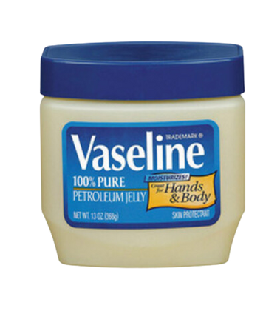





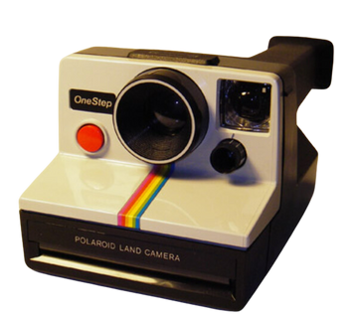

BRANDS THAT OWN THEIR CATEGORY
Petroleun
Jelly
Adhesive
Tape
Search
Engine
Lip Balm
Diapers
Instant Camera

Slide 18
CHAPTER #6
The 22 Immutable Laws of Branding

Slide 19
THE LAW OF CREDENTIALS

Slide 20
STATEMENT
"The crucial ingredient in the success of any brand is its claim to authenticity."

Slide 21
OVERVIEW
The central theme of the 6th law emphasizes the paramount importance of authenticity in brand success.
Authenticity serves as the key claim that elevates a brand above its competitors, making it more believable to consumers.
The law draws on examples, notably Coca-Cola, to illustrate how a genuine claim to authenticity becomes a brand's enduring credential.

Slide 22
CLAIM TO AUTHENTICITY
Authenticity is positioned as the cornerstone of a brand's success.
Claims like lasting longer, requiring less maintenance, or being easier to use might face skepticism, but the claim to authenticity establishes a brand as the real thing, setting it apart from imitations.

Slide 23


EXAMPLE OF COCA -COLA
In 1942, Coca-Cola launched an advertising program called “The only thing like Coca-Cola is Coca-Cola itself. It’s the real thing.”
In 1970, it reprised the “real thing” slogan for about a year.

Slide 24
EXAMPLE OF COCA -COLA
This claim resonated with consumers, establishing the brand as authentic and making every other claim more credible. The concept of "the real thing" has become inseparable from Coca-Cola's identity, emphasizing the enduring power of authentic claims.

Slide 25
CREDENTIALS AND LEADERSHIP
Credentials are portrayed as the collateral a brand puts up to guarantee its performance.
Leadership is identified as the most direct way to establish a brand's credentials.

Slide 26
EXAMPLE OF COCA -COLA
Coca-Cola's historical claim to being "the real thing" is a prime example.
By positioning itself as the authentic cola, Coca-Cola established credentials that went beyond just product features.
The authenticity claim became a powerful form of collateral that contributed to the brand's enduring success and credibility.

Slide 27
CREATING NEW CATEGORIES
If a brand doesn't have the leading position in a category, the strategy is to create a new category where it can claim leadership.
Polaroid succeeded in instant photography but failed in conventional photographic film because it lacked credentials in the latter category.

Slide 28

EXAMPLES
The Beer market is another perfect example of this. When you can’t be the leading beer, you can venture out to other categories like the leading light beer, the leading microbrew, the leading Mexican beer, the leading high-priced beer, the leading German beer, the leading Japanese beer, and so on.
Polaroid succeeded in instant photography but failed in conventional photographic film because it lacked credentials in the latter category.

Slide 29
CREDENTIALS IN PUBLICITY
Credentials play a crucial role in the publicity process.
Reporters and editors are more likely to acknowledge and trust aspects related to a brand's credentials than generic advertising claims.

Slide 30
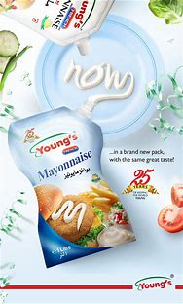
EXAMPLES
Young's has successfully used credentials in its advertisements claiming to be "Pakistan's No. 1 Mayonnaise Brand"
Sure, every advertiser wants the consumer to fall in love with his or her brand and to build brand preference, and loyalty. That’s the effect the advertiser wants to create. But what’s the cause?
Invariably the cause is some variation of the brand’s credentials. ‘It must be good because it’s Pakistan's No. 1 Mayo.’

Slide 31

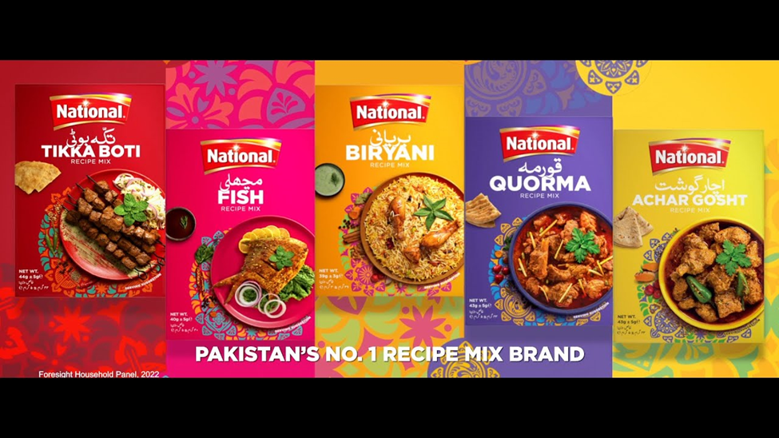
NATIONAL FOODS DOMINANCE IN THE FOOD INDUSTRY
National Foods proudly asserts its leadership in the food industry, particularly in the ketchup category, where it commands an impressive 90% share of Pakistan's ketchup consumers. Additionally, National Foods stands out as the leading brand in Recipe Mix, further solidifying its position as a powerhouse in the culinary landscape.
This leadership claim isn't just a tagline; it's a consistent theme woven into National Foods' advertising strategy. The messaging not only reinforces the brand's dominance but also creates a positive and compelling outlook for consumers.

Slide 32
THE STRATEGIC SIGNIFICANCE OF LEADERSHIP IN BRANDING
IMPORTANCE OF LEADERSHIP
LONG TERM BENEFITS
I
In any market, regardless of its size, possessing leadership credentials is paramount for a brand's success.
The perception of being a leader in a particular category holds immense value.
Consumers often lean towards brands perceived as leaders, enjoying a significant advantage over competitors.
Conversely, certain individuals opt to avoid well-established flagship brands, either favoring lesser-known alternatives or intentionally steering clear of mainstream options.
Achieving leadership in a market isn't just a short-term triumph; it offers enduring benefits.
Once a brand establishes itself as a leader, maintaining that position becomes challenging for competitors.
Long-term leadership contributes to brand loyalty, consumer trust, and a sustained competitive edge.

Slide 33



CONSUMER LOYALTY
Apple continues to maintain its position as a prominent player in the mobile industry.
Despite persistent debates regarding its pricing, battery performance, and perceived benefits, a substantial number of individuals in Pakistan eagerly seek to acquire the latest iPhone, showcasing the enduring allure and desirability of the brand in the market.
Mainly because of the social benefit that this brand brings.
This proves that consumer loyalty and power of authenticity play a vital role in a brands success.

Slide 34
THANK YOU VERY MUCH!

Slide 35
YOUR
QUESTIONS

